Slide 1
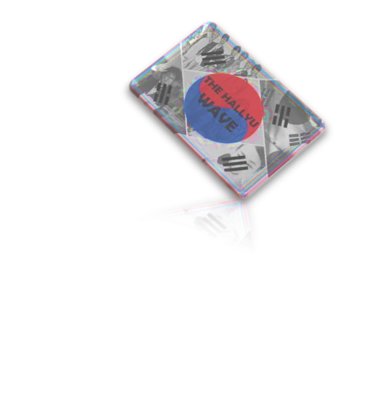

INFLUENCE OF HALLYU ON YOUNGSTERS
JANET JOMY
3RD BSC MATHEMATICS
ST TERESA’S COLLEGE, ERNAKULAM

Slide 2


Hallyu is a Chinese phrase that directly translates to “Korean Wave”.
This research identifies the factors that influence changing customer behavior toward Korean-based products with the effect of lockdown and COVID-19 and preference of choice on Indian and Korean series.
This study gives special reference to K-Electronics, K-Dramas and the frequency of purchases of K-Electronics.
INTRODUCTION

Slide 3

OBJECTIVES
To comprehend the impact
Of K–dramas, electronic products, cosmetics on choices of Kerala's youth.
To understand if the lockdown due to Covid-19 raised the youth's
awareness and understanding
of Korean culture.
To study which medium
(friends, relatives, or social media) influenced
the youth to prefer Hallyu.
To find whether there
is association between price range and frequency
of purchases of K-electronics

Slide 4

DATA DESCRIPTION
The samples are collected with structured questionnaires to collect the primary data and additional information are gathered from journals, articles, social media, and other useful sources
Population of the study
The population of this study is the youth who are attracted to Korean content and Korean culture.
SAMPLE SIZE:
The sample is limited to 327 young people who are influenced by Korean entertainment and Korean culture.

Slide 5

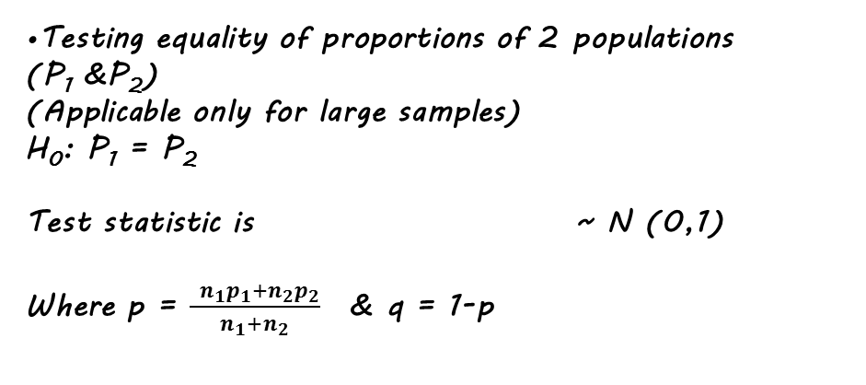
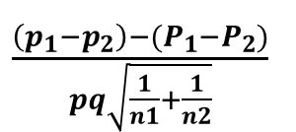

METHODOLOGY
EXPLORATORY DATA ANALYSIS:
Here we use different types of graphs and pie charts for analyzing the qualitative data.
The obtained data were tabulated and analyzed using Microsoft Excel, SPSS and R programming.
The survey consisted of questionnaires on awareness, advantages and preference of Korean products in India.
TEST OF PROPORTION
Test statistic:
Z =
Testing equality of proportions of 2 populations
(P₁ &P₂)
(Applicable only for large samples)
H₀: P₁ = P₂
Test statistic is ~ N (0,1)
Where p = $\frac{ n_{1}p_{1}+n_{2}p_{2}}{n_{1}+n_{2}}$ & q = 1-p
$$\frac{(p−P_{O})}{\sqrt{\frac{((P_{0}(1− P_{0}))}{n}}}$$
$\frac{\left(p_{1}−p_{2}\right)−(P_{1}−P_{2})}{pq\sqrt{\frac{1}{n1}+\frac{1}{n2}}}$

Slide 6
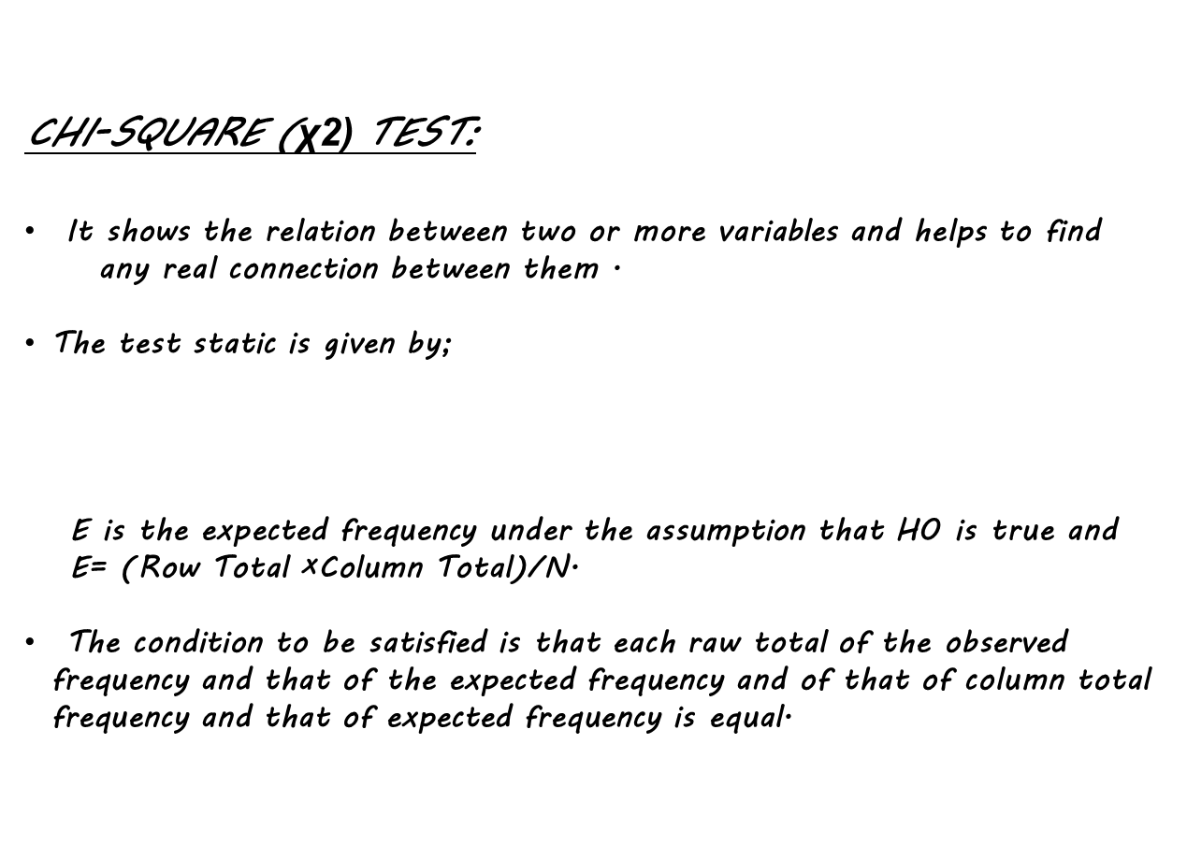
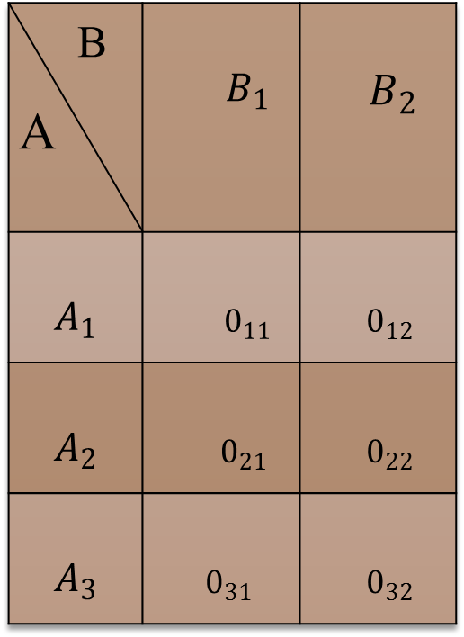
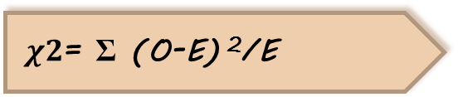
B A | $${ B}_{1}$$ | $${ B}_{2}$$
$$A_{1}$$ | $${ 0}_{11}$$ | $0_{12}$
$$A_{2}$$ | $$0_{21}$$ | $0_{22}$
$$A_{3}$$ | $0_{31}$ | $0_{32}$
CHI-SQUARE (χ2) TEST:
It shows the relation between two or more variables and helps to find
any real connection between them .
The test static is given by;
E is the expected frequency under the assumption that H0 is true and
E= (Row Total ×Column Total)/N.
The condition to be satisfied is that each raw total of the observed frequency and that of the expected frequency and of that of column total frequency and that of expected frequency is equal.
$χ2$= Σ (O-E) ²/E

Slide 7
DATA ANALYSIS
1.TO WHICH AGE GROUP YOU BELONG TO?
2. TO WHICH GENDER IDENTITY DO YOU MOST IDENTIFY TO?
3. ARE YOU AWARE OF KOREAN WAVE IN INDIA WHICH INCLUDE K-DRAMAS, K-ELECTRONICS, K-FASHION, COSMETICS...,ETC?
4. THROUGH WHICH PLATFORM DID YOU
COME TO KNOW ABOUT KOREAN WAVE (HALLYU)?
5. THROUGH WHICH MEDIUM DID YOU GET ACCQUAINTED TO KOREAN WAVE?
6.WHICH OF THE FOLLOWING WOULD YOU PREFER?

Slide 8
7. WHAT IS YOUR PREFERED PRICE RANGE
FOR PURCHASE OF THE ABOVE OPTED BRAND?
8. HOW OFTEN WOULD YOU LIKE TO PURCHASE IT?
PRICE RANGE
9. DO YOU AGREE IF WE SAY THAT KOREANSKINCARE AND BEAUTY BRANDS IS GAINING POPULARITY IN INDIA?
10.YOU PREFER TO WATCH INDIAN SERIES
OR KOREAN SERIES?
11. WERE YOU AWARE OF KOREAN WAVE(HALLYU) BEFORE COVID-19 ?
8

Slide 9
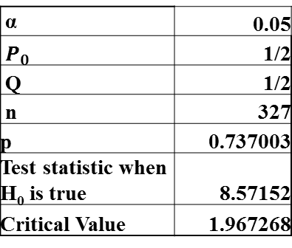
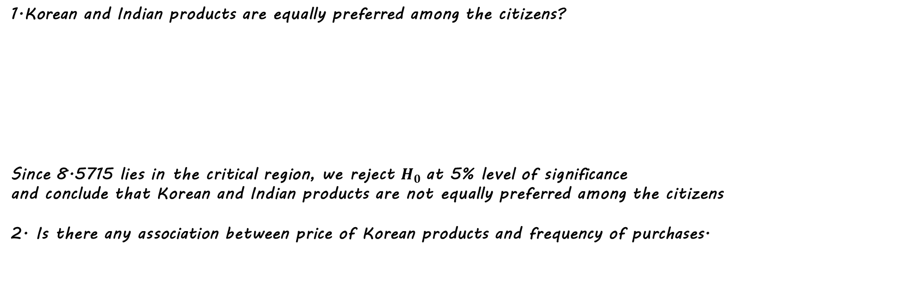
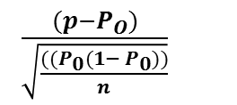
RESULTS
1.Korean and Indian products are equally preferred among the citizens?
Since 8.5715 lies in the critical region, we reject $H_{0}$at 5% level of significance
and conclude that Korean and Indian products are not equally preferred among the citizens
2. Is there any association between price of Korean products and frequency of purchases.
α | 0.05
$P_{0}$ | 1/2
Q | 1/2
n | 327
p | 0.737003
Test statistic when H₀ is true | 8.57152
Critical Value | 1.967268
 | H₀: Korean and Indian products are equally preferred among the citizens i.e. $P_{0}$=1/2
 | H₁:Korean and Indian products are not equally preferred among the citizens i.e.$P_{0}$≠1/2
$\frac{(p−P_{O})}{\sqrt{\frac{((P_{0}(1− P_{0}))}{n}}}$
α : level of significance Test statistic used: Z =
n: total no: of respondents
p: Proportion of people who are influenced by Korean products
H₀: Price of Korean products and frequency of purchases are independent.
H₁: Price of Korean products and frequency of purchases are not independent.
 |  | PRICE RANGE
 | ORIGINAL FREQUENCY | BELOW 15K | 15K-30K | 30K AND ABOVE | TOTAL
PURCHASE FREQUENCY | FREQUENTLY | 6 | 8 | 5 | 19
 | OCCASIONALLY | 26 | 56 | 14 | 96
 | RARELY | 49 | 52 | 10 | 111
 | NEVER | 4 | 6 | 5 | 15
 | TOTAL | 85 | 122 | 34 | 241
Since 14.7355 lies in the critical region, we reject H₀ at 5% level of significance and conclude that Price of Korean products and frequency of purchases are not independent
α | 0.05
Test statistic | 14.73555
Critical Value | 12.59

Slide 10
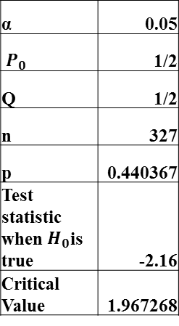
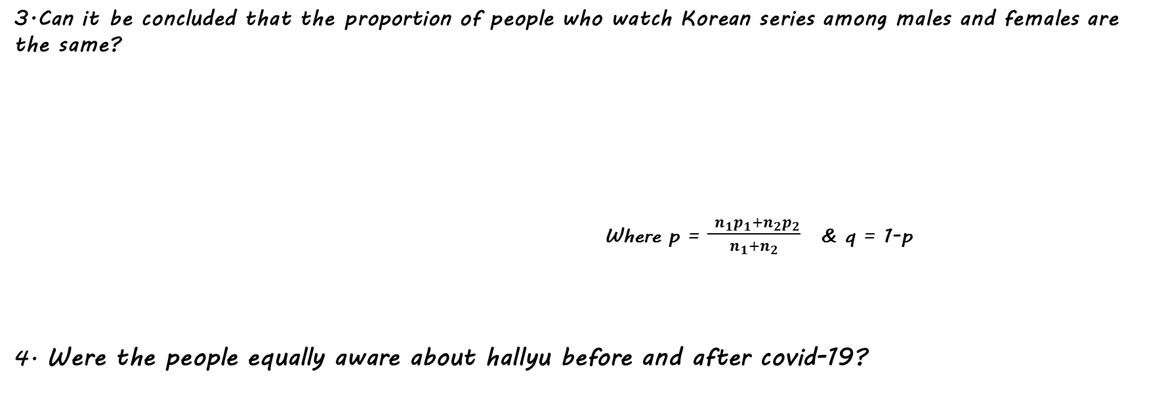
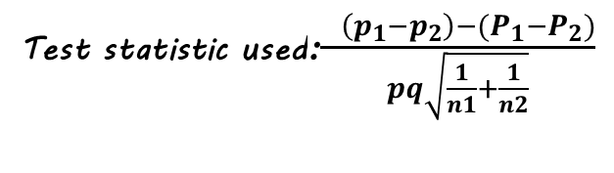
3.Can it be concluded that the proportion of people who watch Korean series among males and females are the same?
Where p = $\frac{ n_{1}p_{1}+n_{2}p_{2}}{n_{1}+n_{2}}$ & q = 1-p
4. Were the people equally aware about hallyu before and after covid-19?
H₀ : P₁=P₂ i.e. The proportion of people who watch Korean series among males and females are the same
H₁ : P₁≠P₂ i.e. The proportion of people who watch Korean series among males and females are not the same
α | 0.05
n₁ | 188
p₁ | 0.829787
n₂ | 139
p₂ | 0.611511
p | 0.737003
q | 0.262997
Test statistic | 4.432098
Critical value | 1.967268
Test statistic used:$\frac{ \left(p_{1}−p_{2}\right)−(P_{1}−P_{2})}{pq\sqrt{\frac{1}{n1}+\frac{1}{n2}}}$
α : level of significance
n₁ : total no: of females
n₂ : total no: of males
p₁ : proportion of females who watch Korean series
p_{2 :} proportion of males who watch Korean series
Since 4.432 lies in the critical region, we reject H₀ at 5% level of significance and conclude that people who watch Korean series among males and females are not the same.
α | 0.05
$P_{0}$ | 1/2
Q | 1/2
n | 327
p | 0.440367
Test statistic when $H_{0}$is true | -2.16
Critical Value | 1.967268
H₀: The people aware of Hallyu before and after covid -19 were equal. i.e. P=1/2
H₁:The people aware of Hallyu before and after covid -19 were not equal i.e. P≠1/2
α : level of significance
n: total no: of respondents
p: Proportion of people who were aware about hallyu before covid-19.
Since -2.16 lies in the critical region, we reject $H_{0}$ at 5% level of significance and conclude that the people aware of hallyu before and after covid -19 were not equal.

Slide 11
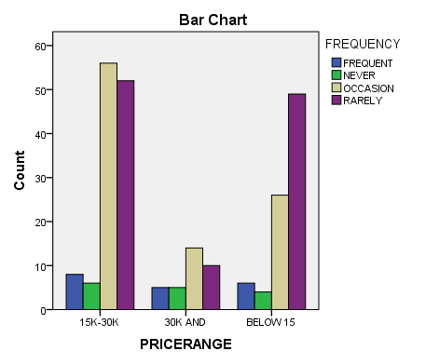

5. Can it be concluded that the proportion of people who get acquainted through k-DRAMAS among males and females are the same.
α | 0.05
n₁ | 188
p₁ | 0.420213
n₂ | 139
p₂ | 0.215827
p | 0.333333
q | 0.666667
Test statistic | 3.875865
Critical value | 1.967268
H₀: P1=P2 i.e. The proportion of people who get acquainted through k-DRAMAS among males and females are the same.
H₁: P1≠P2 i.e. The proportion of people who get acquainted through k-DRAMAS among males and females are not the same.
α : level of significance
n₁ : total no: of females
n₂ : total no: of males
p₁ : proportion of females who watch Korean series
p_{2 :} proportion of males who watch Korean series
Since 3.8758 lies in the critical region, we reject H₀ at 5% level of significance and conclude that people who get acquainted through k-DRAMAS among males and females are not the same.
USING SPSS
Chi-Square Tests
 | Value | df | Asymp. Sig. (2-sided)
Pearson Chi-Square | 14.736ª | 6 | .022
Likelihood Ratio | 13.533 | 6 | .035
N of Valid Cases | 241

Slide 12


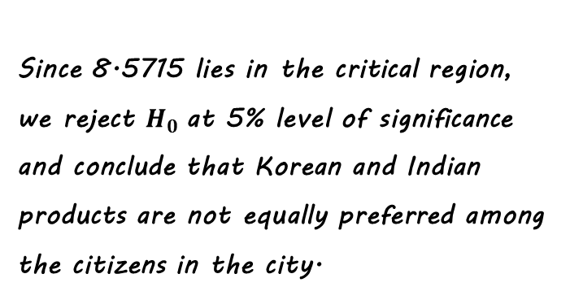
USING R
H₀: Korean and Indian products are equally preferred among the citizens in the city i.e. P=1/2
H₁:Korean and Indian products are not equally preferred among the citizens in the city i.e. P≠1/2
Since 8.5715 lies in the critical region, we reject $H_{0}$at 5% level of significance
and conclude that Korean and Indian products are not equally preferred among
the citizens in the city.

Slide 13







CONCLUSION
It was found that most of the individuals used to purchase Korean electronics occasionally in the price range 15k – 30k. Quality and price are found to be the major reasons for the preference of Korean products over Indian products according to the majority of respondents.
According to our study, there was only a slight difference in the preference of Indian and Korean series. Here bringing more advancement both content and presenting wise can increase the competition in both the fields.
Another objective was to find whether Lockdown due to pandemic (covid-19) has lead the individuals to know more about Hallyu.The Lockdown seemed to have given the young people more time and interest in exploring Korean content
According to our study and reference, it seems like Hallyu may swell as a tidal wave in future in various countries including India with the youngsters being a major part of it.

Slide 14

1
The Hindu. (2021). The rising Korean wave in India. 1–9. https://www.thehindu.com/life-and-style/travel/the-rising-korean-wave-in-india/article34364824.ece
2
The Times of India. (2021). Korean food trends gaining popularity in India.
REFERENCES
3
Simon, A. (2021). University Students ’ Perceptions of Korean Wave and Its Impact on Their Views of Korea and Korean Culture. Human Behavior, Development and Society, 22(1), 7–18.
4
Kanozia, R., & Ganghariya, G. (2021). Cultural proximity and hybridity: the popularity of Korean pop culture in India. Media Asia,48(3),219–228. https://doi.org/10.1080/01296612.2021.1902079.
5
Chakraborty, R. (2020). Exclusive : BTS Reflect on the Massive Success of ‘ Dynamite ’ in India. 1–11. https://rollingstoneindia.com/exclusive-bts-reflect-on-dynamite-massive-success-in-india/

Slide 15

Thank You

